Slide 1
System Requirements Definition
Module 3

Slide 2
Outline
Inputs-Activities-Outputs of Process
Characteristics of Good Requirements
Rules for Writing Requirements Statements
Stakeholder Requirements to System Requirements
System Requirements to Sub System Requirements
SW Requirements
HW Requirements

Slide 3
System Requirements Definition Process
The purpose of the System Requirements Definition process is to transform the stakeholder, user-oriented view of desired capabilities into a technical view of a solution that meets the operational needs of the user.
(INCOSE Systems Engineering Handbook, v4)

Slide 4
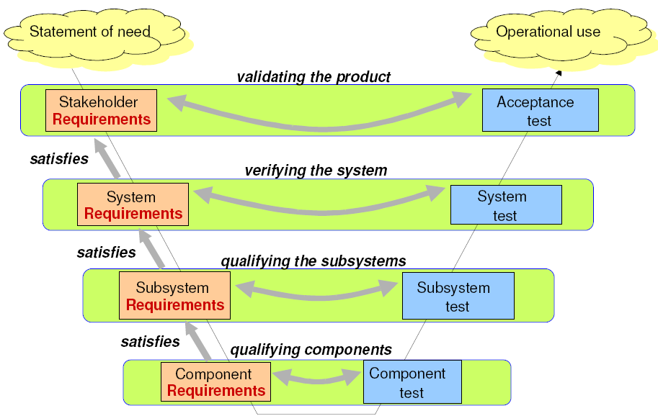
Problem
Domain
Did we build the right system?
Solution
Domain
Did we build the system right?

Slide 5
System Requirements
System requirements are all of the requirements at the system level that describe the functions which the system as a whole should fulfill to satisfy the stakeholder needs and requirements, and are expressed in an appropriate combination of textual statements, views, and non-functional requirements; the latter expressing the levels of safety, security, reliability, etc., that will be necessary.
System requirements play major roles in systems engineering:
Basis of system architecture and design activities
Basis of system integration and verification activities
Means of communication between the various technical staff that interact throughout the project
Every requirement carries a cost!

Slide 6
Inputs-Activities-Outputs of Process

Slide 7
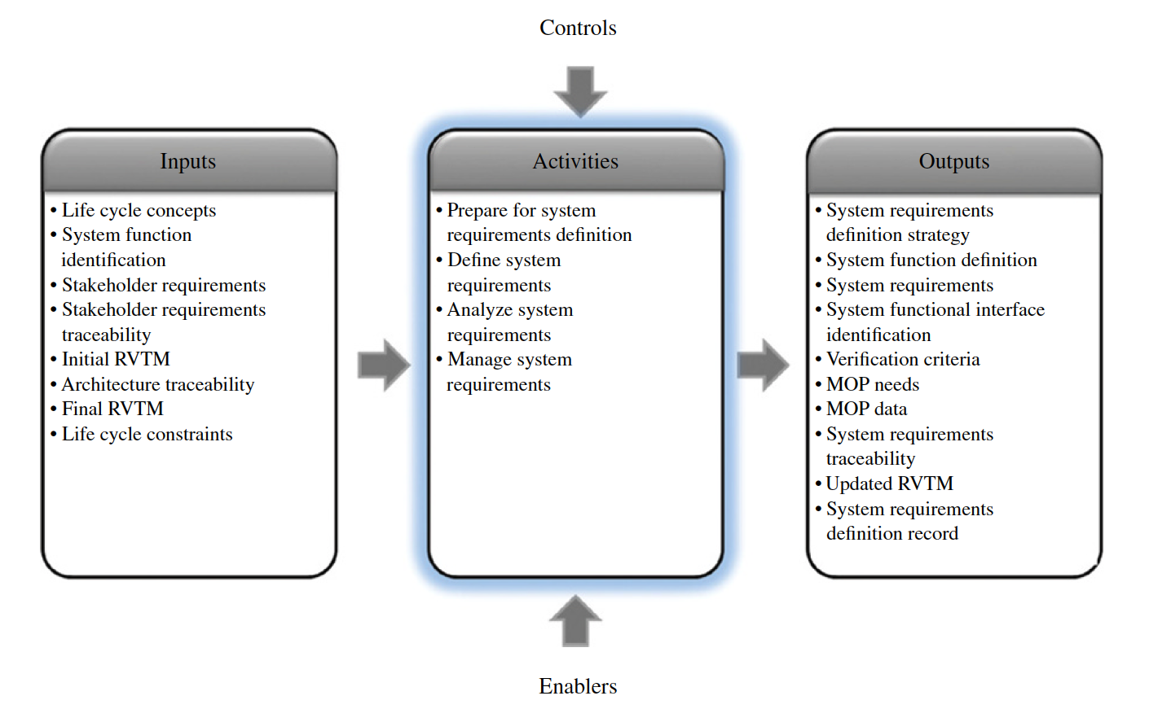
IPO Diagram

Slide 8
Major Activities
Define System Requirements
Analyze Integrity of System Requirements
Define Verification Criteria

Slide 9
Major Artifacts
System Requirements Document
System External Interface Requirements Document
System Requirements Justification Documents
System Requirements Traceability

Slide 10
Characteristics of Good Requirements

Slide 11
Characteristics of Good Requirements (Individual)
C1 – Necessary
C2 – Appropriate
C3 – Unambiguous
C4 – Complete
C5 – Singular
C6 – Feasible
C7 – Verifiable
C8 – Correct
C9 – Conforming
Source: INCOSE Guide to Writing Requirements

Slide 12
C1 – Necessary
If the requirement is not included, a deficiency in the capability or characteristic will exist, which cannot be fulfilled by implementing other requirements
A requirement is NOT necessary if:
The requirement can be removed and the remaining set will still result in the needs being satisfied
The requirement cannot be traced back to a source, need, or parent requirement
The author cannot communicate a valid reason (rationale) for the requirement

Slide 13
C1 – Necessary Example
Unacceptable:
SR98: When ice is detected, car shall inform the user
SR101: When ice is detected, car shall show an ice icon in less than 0.5 seconds from its detection
Improved (Removed duplicate vague requirement)
SR101: When ice is detected, car shall show an ice icon in less than 0.5 seconds from its detection

Slide 14
C2 – Appropriate
The specific intent and amount of detail of the requirement is appropriate to the level of the entity to which it refers
Level: of abstraction, organization, or system architecture (system, subsystem, or system elements)
A requirement stated at the wrong level for an entity is either not correct or may not be verifiable at that level

Slide 15
C2 – Appropriate Example
Unacceptable:
Example 1:
SR110: The user shall be categorized either as trusted or Not_Trusted
Example 2:
SR201: Thermistor input ADC shall have resolution of 10 bit
Improved
SR110: The Security_System shall categorize each user as either Trusted or Not_Trusted
SR201: Temperature_Measurement_System shall detect temperature with 0.1 degree C resolution

Slide 16
C3 – Unambiguous
Requirement statements must be stated such that the requirement can be interpreted in only one way by all the intended stakeholders.
Ambiguity leads to interpretations not intended by the author, leading to problems such as schedule slips, budget overruns, failure of the SOI to pass system validation, and not be accepted for its intended use.

Slide 17
C3 – Unambiguous Example
Unacceptable:
SR110: When the clutch is disengaged and/or the break is applied, the Engine_Management_System shall disengage the Speed_Control_System within xxx milliseconds
Improved (Cleared ambiguity for consistent interpretation as per intent)
SR110: When the [clutch is disengaged] AND the [break is applied] , the Engine_Management_System shall disengage the Speed_Control_System within xxx milliseconds
OR
SR110: When the clutch is disengaged, the Engine_Management_System shall disengage the Speed_Control_System within xxx milliseconds
SR111: When the break is applied , the Engine_Management_System shall disengage the Speed_Control_System within xxx milliseconds
OR
SR110:When EITHER [the Clutch is disengaged] OR[the Brake is applied] the Engine_Management_System shall disengage the Speed_Control_System within xxx milliseconds

Slide 18
C4 – Complete
The requirement statement sufficiently describes the necessary capability, characteristic, constraint, or quality factor to meet the need, source, or parent requirement from which it was transformed without needing other information to understand the requirement.
Each requirement should be understood in its own right without having to understand a number of other requirements.
Baselined requirement statements should not contain To Be Defined (TBD), To Be Specified (TBS), or To Be Resolved (TBR) clauses.

Slide 19
C4 – Complete Example
Unacceptable:
SR110: The Thermal_Control_System shall monitor system temperature
Or
SR110:The Thermal_Control_System shall update the display of System temperature
Improved
SR110: The Thermal_Control_System shall update the display of System temperature
every 10 +/-1 second in degree Celsius with an accuracy of +/- 0.2 degree Celsius.

Slide 20
C4 – Complete Example 2
Unacceptable:
SR210: The Corporate_Website shall display Approved_Fonts
Improved (Corrected as per intent)
SR210: : The Corporate_Website shall display information using Approved_Fonts defined in Display_Standards_XXX

Slide 21
C5 – Singular
The requirement statement should state a single capability, characteristic, constraint, or quality factor.
A requirement with multiple thoughts is difficult to allocate and to trace to a parent or source.
A nonsingular requirement is not verifiable

Slide 22
C5 – Singular Example
Unacceptable:
SR110: The control system will close the inlet_valve until the temperature has reduced to
85 degree C, when it will then reopen it in less than 1 second
Improved (Split in two requirements each with it’s own time constraint)
SR110: : If the Water_Temperature in the boiler increases to greater than 85 degree C, the Control_Subsystem shall close the Inlet_Valve in less than 1 second
SR111: When the Water_Temperature in the boiler reduces to less than equal to 85 degree C, the Control_Subsystem shall open the Inlet_Valve in less than 1 second

Slide 23
C6 – Feasible
The requirement can be realized within entity constraints (e.g.: cost, schedule, technical, legal, ethical, safety) with acceptable risk.
An infeasible need or requirement cannot be satisfied because
it breaks the laws of physics,
it violates laws or regulations in an applicable jurisdiction,
it conflicts with another requirement and cannot be concurrently satisfied, or
it leads to excessive program risk because of technical immaturity or inadequate cost/schedule margin

Slide 24
C6 – Feasible Example
Unacceptable:
SR210: The periodicity of the Engine RPM CAN Signal shall be 0.01 ms.
Improved (clear the definition)
SR210: The periodicity if the Engine RPM CAN Message shall be 5 ms.

Slide 25
C7 – Verifiable
The requirement statement is structured and worded such that its realization can be verified to the approving authority’s satisfaction.
Otherwise, there is no way to tell if it has been satisfied and that the obligation has been met.
A requirement may not to be verifiable if there is:
no clear definition of the correct functional behavior, conditions, and states.
lack of accuracy or feasibility in the ranges of acceptable performance.
use of ambiguous terms.
no feasibility of the requirement.
Absolute

Slide 26
C7 – Verifiable Example
Unacceptable:
SR210: The Weapon_System shall not fail
Improved (clear the definition)
SR210: The Weapon_System shall have availability of greater than or equal to 95%
or
SR210:: The Weapon_System shall have a Mean_Time_Between_Failures of xxxx hours

Slide 27
C8 – Correct
The requirement statement must be an accurate representation of the need, source, or parent requirement from which it was transformed.
Correct implies “no errors” both from the perspective of the inclusion of incorrect information, the omission of required information, and avoidance of ambiguous wording.
Incorrect information can mean having the wrong values, functions, conditions, or other characteristics identified in the requirement.

Slide 28
C8 – Correct Example
Unacceptable:
SR210: The Corporate_Website shall display Approved_Fonts
Improved (Corrected as per intent)
SR210: : The Corporate_Website shall display information using Approved_Fonts defined in Display_Standards_XXX

Slide 29
C9 – Conforming
Requirements should conform to an approved standard pattern and style guide or standard for writing and managing needs and requirements.
When requirements within the same organization have the same look and feel, each requirement statement is easier to write, understand, and review.
The people responsible for writing the needs and requirements may need to conform to the customer’s processes and standards.

Slide 30
Characteristics of Good Requirements (Set)
C10 – Complete
C11 – Consistent
C12 – Feasible
C13 – Comprehensible
C14 – Able to be validated
Source: INCOSE Guide to Writing Requirements

Slide 31
C10 – Complete
The requirement set for a given SOI should stand alone such that it sufficiently describes the necessary capabilities, characteristics, functionality, performance, drivers, constraints, interactions, standards, regulations, and/or quality factors without requiring other sets of requirements
The goal is to clearly communicate the requirements for an SOI via a minimum set that are necessary and sufficient and no more
Completeness of the set of requirements can be facilitated through the use of templates

Slide 32
C11 – Consistent
The set of requirements contains individual requirements that are unique, do not conflict with or overlap with other requirements in the set
The units and measurement systems they use are homogeneous
The language used within the set of requirements is consistent
Consistency in requirements wording is greatly assisted using a centralized domain ontology, glossary, and data dictionary that is shared among all stakeholders.

Slide 33
C12 – Feasible
Set of requirements can be realized within entity constraints (e.g., cost, schedule, technical) with acceptable risk.
The combination of feasible individual requirements does not necessarily imply a feasible set of those individual requirements
If feasibility is not addressed early in the development process, it can lead to wasted effort and cost.

Slide 34
C13 – Comprehensible
The set of requirements must be written such that it is clear as to what is expected of the entity and its relation to the macro system of which it is a part.
This set must be written such that the relevant audience can understand what is being communicated
An agreement is difficult to enact unless both parties are clear on the exact obligation and the expected outcome(s) as a result of the realization of the entity the set of requirements represents.

Slide 35
C14 – Able to be Validated
It must be able to be validated that the set of requirements will lead to the achievement of the integrated set of needs and higher-level requirements within the constraints (such as cost, schedule, technical, and regulatory compliance) with acceptable risk.
Ask these questions:
“Will the entity developed by this set of requirements satisfy the needs?”
“Are we building the right thing?”

Slide 36
Rules for Writing Requirement Statements

Slide 37
Rules (1)
4.1 ACCURACY
R1 - /Accuracy/SentenceStructure
R2 - /Accuracy/UseActiveVoice
R3 - /Accuracy/SubjectVerb
R4 - /Accuracy/UseDefinedTerms
R5 - /Accuracy/UseDefiniteArticles
R6 - /Accuracy/Units
R7 - /Accuracy/AvoidVagueTerms
R8 - /Accuracy/NoEscapeClauses
R9 - /Accuracy/NoOpenEnded
4.2 CONCISION
R10 - /Concision/SuperfluousInfinitives
R11 - /Concision/SeparateClauses
4.3 NON-AMBIGUITY
R12 - /NonAmbiguity/CorrectGrammar
R13 - /NonAmbiguity/CorrectSpelling
R14 - /NonAmbiguity/CorrectPunctuation
R15 - /NonAmbiguity/LogicalCondition
R16 - /NonAmbiguity/AvoidNot
R17 - /NonAmbiguity/Oblique
4.4 SINGULARITY
R18 - /Singularity/SingleSentence
R19 - /Singularity/AvoidCombinators
R20 - /Singularity/AvoidPurpose
R21 - /Singularity/AvoidParentheses
R22 - /Singularity/Enumeration
R23 - /Singularity/Context

Slide 38
Rules (2)
4.5 COMPLETENESS
R24 - /Completeness/AvoidPronouns
R25 - /Completeness/UseOfHeadings
4.6 REALISM
R26 - /Realism/AvoidAbsolutes
4.7 CONDITIONS
R27 - /Conditions/Explicit
R28 - /Conditions/ExplicitLists
4.8 UNIQUENESS
R29 - /Uniqueness/Classify
R30 - /Uniqueness/ExpressOnce
4.9 ABSTRACTION
R31 - /Abstraction/SolutionFree
4.10 QUANTIFIERS
R32 - /Quantifiers/Universals
4.11 TOLERANCE
R33 - /Tolerance/ValueRange
4.12 QUANTIFICATION
R34 - /Quantification/Measurable
R35 - /Quantification/TemporalIndefinite
4.13 UNIFORMITY OF LANGUAGE
R36 - /UniformLanguage/UseConsistentTerms
R37 - /UniformLanguage/DefineAcronyms
R38 - /UniformLanguage/AvoidAbbreviations
R39 - /UniformLanguage/StyleGuide
4.14 MODULARITY
R40 - /Modularity/RelatedRequirements
R41 - /Modularity/Structured

Slide 39
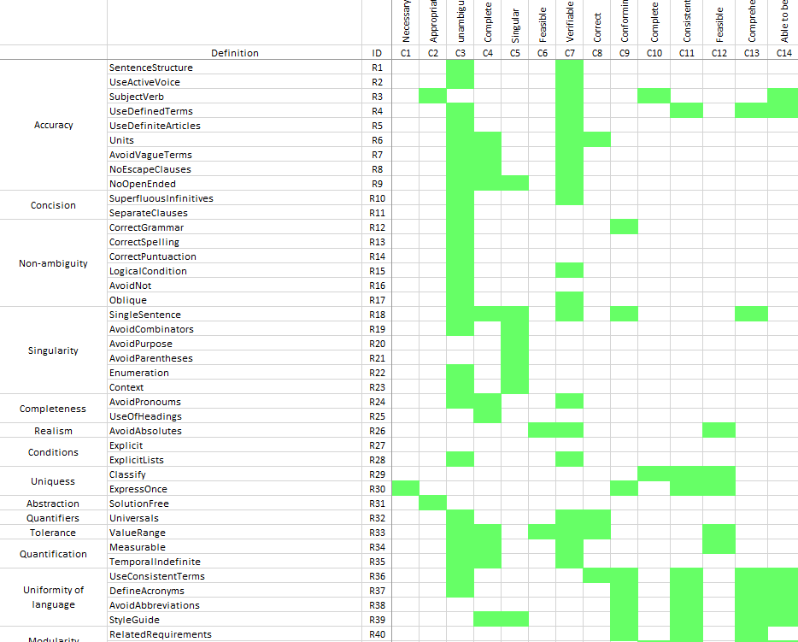
Rules to Characteristics Mapping
Source: Guide for writing good requirements - Helder Castro

Slide 40
Rules – Accuracy (1)
R1 - /Accuracy/SentenceStructure
Basic structure: The <entity> shall <action verb> <object>
Example: The water bottle shall hold 1 litre of water
R2 - /Accuracy/UseActiveVoice
Unacceptable: The audio shall by played by the system
Acceptable: The system shall play audio

Slide 41
Rules – Accuracy (2)
R3 - /Accuracy/SubjectVerb
Unacceptable: The User shall
Acceptable: The <system> shall
Unacceptable The car shall have legroom of…
Acceptable The Rear_Passenger_Seat shall have Legroom of…

Slide 42
Rules – Accuracy (3)
R4 - /Accuracy/UseDefinedTerms
Unacceptable: The system shall display the current date
Acceptable: The system shall display the Current_Date in DD/MM/YYYY format
R5 - /Accuracy/UseDefiniteArticles
Unacceptable: The system shall provide a time display
Acceptable: The system shall display the Current_Time

Slide 43
Rules – Accuracy (4)
R6 - /Accuracy/Units
R7 - /Accuracy/AvoidVagueTerms
Unacceptable The system shall … at a maximum ambient temperature of approximately 60 degrees
Acceptable The system shall … in the temperature range of -10 degrees Celsius to +60 degrees Celsius

Slide 44
Rules – Accuracy (5)
R8 - /Accuracy/No Escape Clauses
Unacceptable: The system shall, as far as possible, conform to Clause a) of Standard ABC
Acceptable: The system shall conform to Clause a) of Standard ABC
R9 - /Accuracy/NoOpenEnded
Unacceptable: The display_unit shall display date, time, temperature, etc.
Acceptable: The display unit shall display Current_Date The display unit shall display Current_Time The display unit shall display Current_Temperature

Slide 45
Rules - Concision
R10 - /Concision/Superfluous Infinitives
Unacceptable The system shall be designed to be able to…
Acceptable The system shall…
R11 - /Concision/Separate Clauses

Slide 46
Rules – Non-Ambiguity (1)
R12 - /NonAmbiguity/CorrectGrammar
R13 - /NonAmbiguity/CorrectSpelling
R14 - /NonAmbiguity/CorrectPunctuation
R15 - /NonAmbiguity/LogicalCondition
Unacceptable: The system shall X and Y
Acceptable: The system shall [X AND Y]

Slide 47
Rules – Non-Ambiguity (2)
R16 - /NonAmbiguity/AvoidNot
R17 - /NonAmbiguity/Oblique
Unacceptable The system shall X and/or Y
Acceptable The system shall X The system shall Y

Slide 48
Rules – Singularity (1)
R18 - /Singularity/SingleSentence
R19 - /Singularity/AvoidCombinators
R20 - /Singularity/AvoidPurpose
Unacceptable: The system shall… because
Acceptable: The system shall…
R21 - /Singularity/AvoidParentheses

Slide 49
Rules – Singularity (2)
R22 - /Singularity/Enumeration
Unacceptable: The system shall display performance information
Acceptable: The system shall display parameter #1 The system shall display parameter #2
R23 - /Singularity/Context
Unacceptable: The system shall… X while Y within Z when A
Acceptable: The system shall… as specified in Diagram #1

Slide 50
Rules - Completeness
R24 - /Completeness/AvoidPronouns
Unacceptable: The system shall receive from the user, his inputs
Acceptable: The system shall receive inputs from User
R25 - /Completeness/UseOfHeadings
Unacceptable: 5 Airbag Requirements 5.1 The car shall deploy them within X seconds of impact
Acceptable: The car shall deploy Airbags in less than X seconds after Impact

Slide 51
Rules – Realism, Conditions
R26 - /Realism/AvoidAbsolutes
Unacceptable: The system shall never…
Acceptable: The system shall… greater than or equal to 95%
R27 - /Conditions/Explicit
Unacceptable: When X happens, the power shall be turned off
Acceptable: In the event of X, the system shall turn off power

Slide 52
Rules - Conditions, Uniqueness
R28 - /Conditions/ExplicitLists
R29 - /Uniqueness/Classify
R30 - /Uniqueness/ExpressOnce
Unacceptable: The system shall generate a report of financial transactions The system shall generate a Financial_Transaction_Report

Slide 53
Rules – Abstraction, Quantifiers
R31 - /Abstraction/SolutionFree
R32 - /Quantifiers/Universals
Unacceptable: The Operation_Logger shall record any (or all) warning messages
Acceptable: The Operation_Logger shall record each Warning_Message.

Slide 54
Rules – Tolerance, Quantification
R33 - /Tolerance/ValueRange
Unacceptable: The system shall… at acceptable levels
Acceptable: The system shall… within the range X to Y
R34 - /Quantification/Measurable
R35 - /Quantification/TemporalIndefinite
Unacceptable: The system shall…. Immediately
Acceptable The system shall…. Within X seconds of Event_A

Slide 55
Rules – Uniformity of Language
R36 - /UniformLanguage/UseConsistentTerms
R37 - /UniformLanguage/DefineAcronyms
R38 - /UniformLanguage/AvoidAbbreviations
R39 - /UniformLanguage/StyleGuide

Slide 56
Rules - Modularity
R40 - /Modularity/Related Requirements
R41 - /Modularity/Structured

Slide 57
Stakeholder Requirements to System Requirements

Slide 58
Needs to Requirements
Stakeholder
Needs
Problem Domain
Solution Domain
Stakeholder
Needs
Stakeholder
Requirements
System
Requirements
What Stakeholders
EXPECT from the System
What the System must
DO / FULFILL
Stakeholder
Needs

Slide 59
System Requirements Classification
Functional Requirements
Performance Requirements
Usability Requirements
Interface Requirements
Operational Requirements
Modes and/or States Requirements
Adaptability Requirements
Physical Constraints
Design Constraints
Environmental Conditions
Logistical Requirements
Policies and Regulations
Cost and Schedule Constraints
Regulatory Requirements
Source: SEBoK

Slide 60
System Requirements Classification
Types of System Requirement | Description
Usability Requirements | Define the quality of system use (e.g. measurable effectiveness, efficiency, and satisfaction criteria).
Interface Requirements | Define how the system is required to interact or to exchange material, energy, or information with external systems (external interface), or how system elements within the system, including human elements, interact with each other (internal interface). Interface requirements include physical connections (physical interfaces) with external systems or internal system elements supporting interactions or exchanges.
Operational Requirements | Define the operational conditions or properties that are required for the system to operate or exist. This type of requirement includes: human factors, ergonomics, availability, maintainability, reliability, and security.
Modes and/or States Requirements | Define the various operational modes of the system in use and events conducting to transitions of modes.
Adaptability Requirements | Define potential extension, growth, or scalability during the life of the system.
Physical Constraints | Define constraints on weight, volume, and dimension applicable to the system elements that compose the system.
Design Constraints | Define the limits on the options that are available to a designer of a solution by imposing immovable boundaries and limits (e.g., the system shall incorporate a legacy or provided system element, or certain data shall be maintained in an online repository).
Environmental Conditions | Define the environmental conditions to be encountered by the system in its different operational modes. This should address the natural environment (e.g. wind, rain, temperature, fauna, salt, dust, radiation, etc.), induced and/or self-induced environmental effects (e.g. motion, shock, noise, electromagnetism, thermal, etc.), and threats to societal environment (e.g. legal, political, economic, social, business, etc.).
Logistical Requirements | Define the logistical conditions needed by the continuous utilization of the system. These requirements include sustainment (provision of facilities, level support, support personnel, spare parts, training, technical documentation, etc.), packaging, handling, shipping, transportation.
Policies and Regulations | Define relevant and applicable organizational policies or regulatory requirements that could affect the operation or performance of the system (e.g. labor policies, reports to regulatory agency, health or safety criteria, etc.).
Cost and Schedule Constraints | Define, for example, the cost of a single exemplar of the system, the expected delivery date of the first exemplar, etc.
Source : SEBOK WIKI

Slide 61
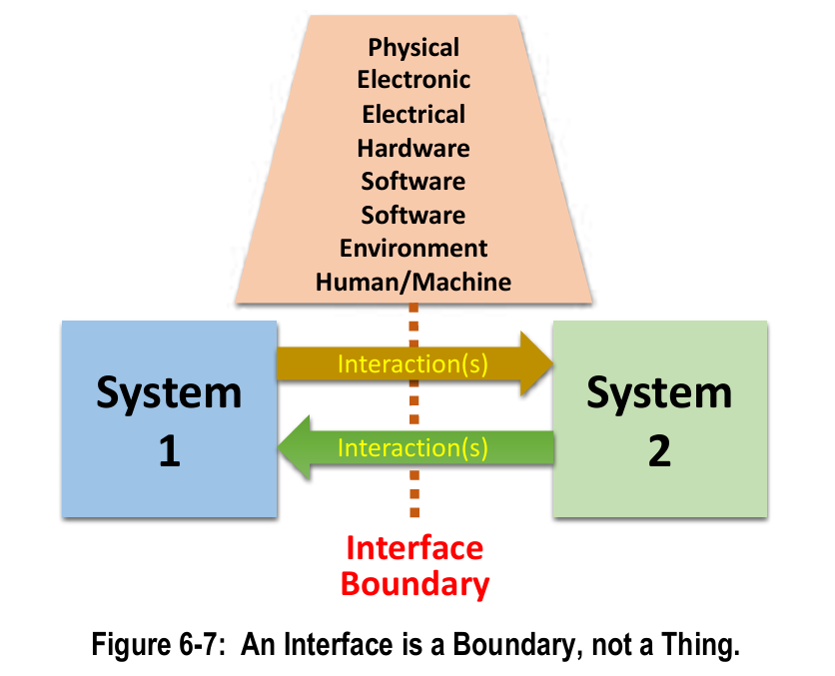
Interface Requirements
The interaction could be direct (actual connection between two systems or
Indirect (no direct connection but there is some design feature of a system that can affect a design feature of another system, e.g., induced environments or competition for a common resource).
INCOSE-TP-2021-002-01 | VERS/REV: 1.1 | May 2022

Slide 62
What an Interface is not!
A general rule is that the word “interface” should not be used in a requirement statement either as a noun or a verb.
As a noun, it implies the interface is a thing, which it is not - it is a boundary across which, or at, two systems interact.
As a verb, it is ambiguous, in that often there are multiple interactions between systems across a single interface boundary.
It is a best practice to focus on individual interactions when writing interface requirements. This is important from both a system verification perspective and an allocation perspective.
INCOSE-TP-2021-002-01 | VERS/REV: 1.1 | May 2022

Slide 63
Example of how not to write Interface Requirements
Incorrect Requirement | Explanation | System A Requirement | System B Requirement
The digital interface shall maintain full operational capability after two failures. | This requirement assumes the interface is a tangible thing with functionality - this is not true. | The digital system on the spacecraft side shall maintain operational capability by handling up to two failures in data exchange. | The digital system on the payload side shall maintain operational capability by handling up to two failures in data exchange.
The interfaces between the spacecraft and payload shall be designed to …. | This requirement is written in passive voice on the designers and also assumes the interfaces are things. The requirement should focus on accessibility of connectors, bolts, etc. | The spacecraft shall provide accessible connectors and bolts for attachment to the payload. | The payload shall provide accessible connectors and bolts for attachment to the spacecraft.
The interfaces between the spacecraft and payload shall have standard labels, controls, and displays. | This requirement is written in passive voice and again assumes the interface is a thing. | The spacecraft shall include standardized labels, controls, and displays at the interface for ease of use. | The payload shall include standardized labels, controls, and displays at the interface for ease of use.
The electrical interface between the spacecraft and payload shall have a reliability of 0.99999. | This requirement again assumes the interface is a thing. The requirement should address each of the systems and apply to any hardware or software involved in interactions on each side of the interface boundary. | The electrical system on the spacecraft side shall maintain a reliability of 0.99999 in operations involving the payload. | The electrical system on the payload side shall maintain a reliability of 0.99999 in operations involving the spacecraft.
The SOI shall interface with …... | This requirement is ambiguous because it does not focus on a specific interaction. There are often multiple interactions; to be specific, there should be a requirement for each interaction. | The SOI shall enable data exchange with the payload's telemetry system. | The payload shall establish a secure data connection with the SOI for telemetry exchange.

Slide 64
Steps to write Interface Requirements
Writing interface requirements is a three-step process:
Step 1: Identify the interface boundaries and interactions across those boundaries
Step 2: Define the interactions across the interface boundaries
Step 3: Write the Interface requirements.
INCOSE-TP-2021-002-01 | VERS/REV: 1.1 | May 2022

Slide 65
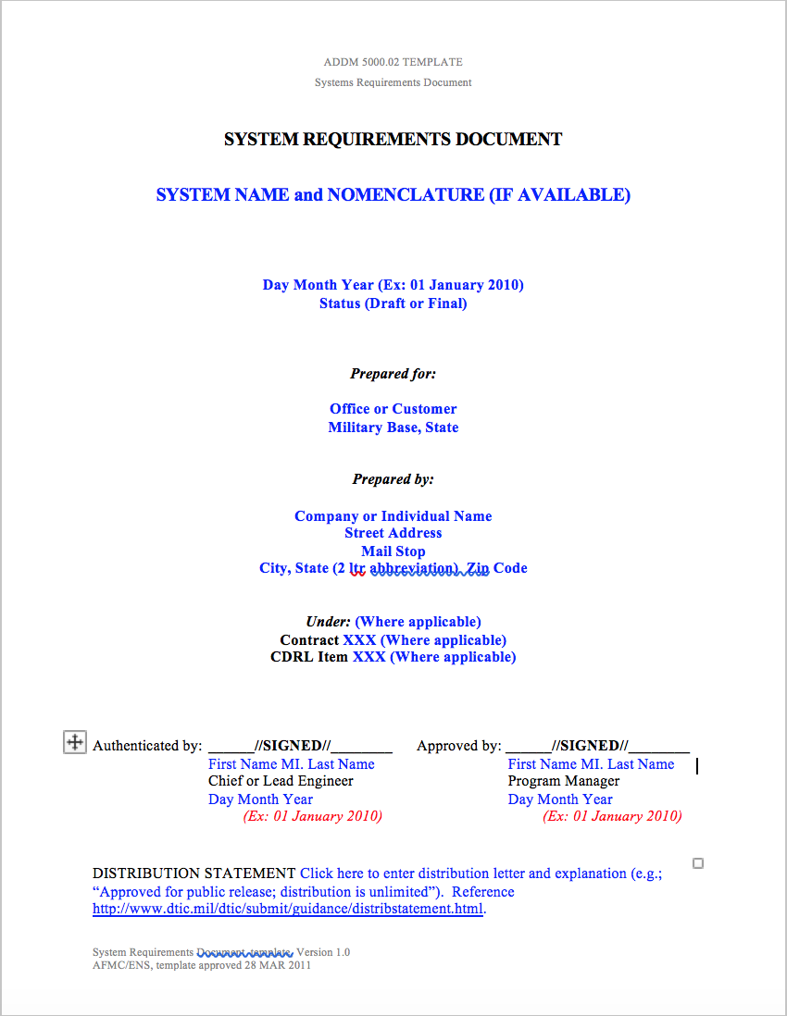
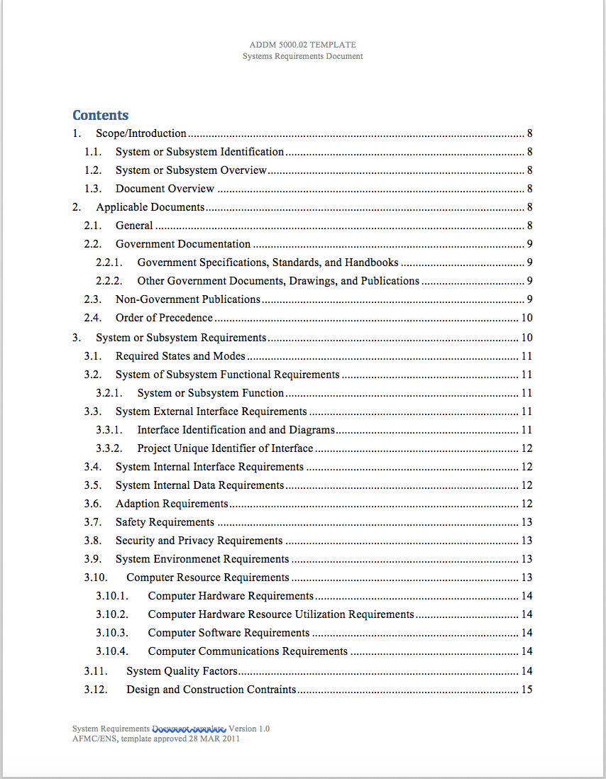
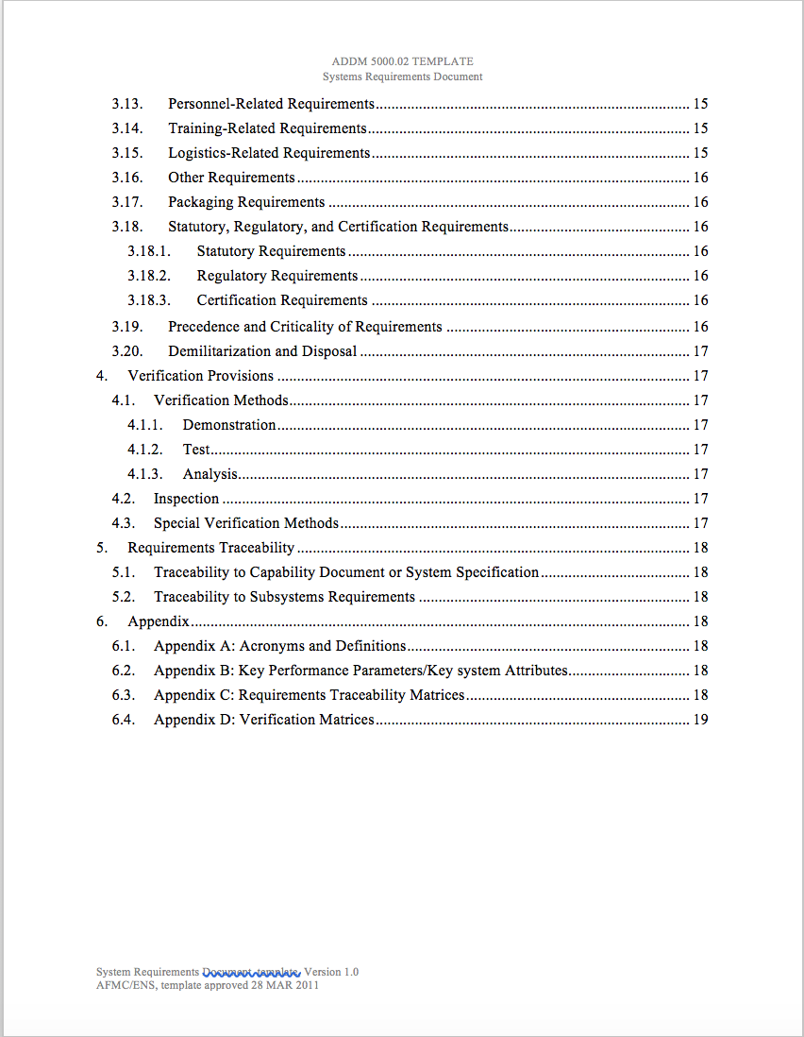
System Requirements Document - Template

Slide 66
Examples of Requirements
The <system> shall not fail.
{This is unacceptable because verification of the requirement would require infinite time.}
Acceptable:
The <system> shall have an Availability of greater than or equal to 95%.
OR
The <system> shall have a Mean Time Between Failures (MTBF) of 6 months.
INCOSE - Guide for Writing Requirements

Slide 67
Examples of Requirements
The User_Management_System shall Open/Close the User_Account in less than 1 second.
{This is unacceptable because it is unclear as to what is meant: open, close, or both?}
Acceptable (Split into two requirements):
The User_Management_System shall Open the User_Account in less than 1 second.
The User_Management_System shall Close the User_Account in less than 1 second.
INCOSE - Guide for Writing Requirements

Slide 68
Good Requirements or Bad Requirements?
The smart watch shall be very nice looking and easy to use.
The smart watch shall work without charging for 10 hours.
The smart watch display shall be circular with 1 inch diameter.

Slide 69
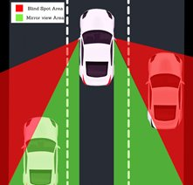
Exercise 3.1
For your BSD ,
Transform some Stakeholder Requirements into System Requirements (following characteristics of good system requirements, and using the format “The <system> shall…”) while doing so please rectify the stakeholder requirements according to good requirement rules
Indicate one Stakeholder Requirement in one row
Some Stakeholder Requirements may translate into more than one System Requirement

Slide 70
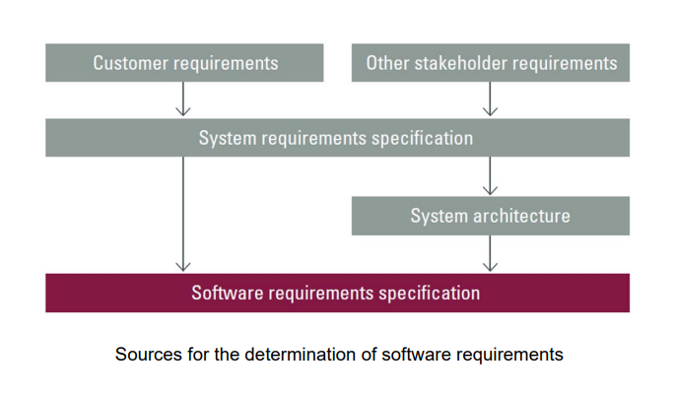
SOFTWARE REQUIREMENTS AND HW REQUIREMENTS

Slide 71
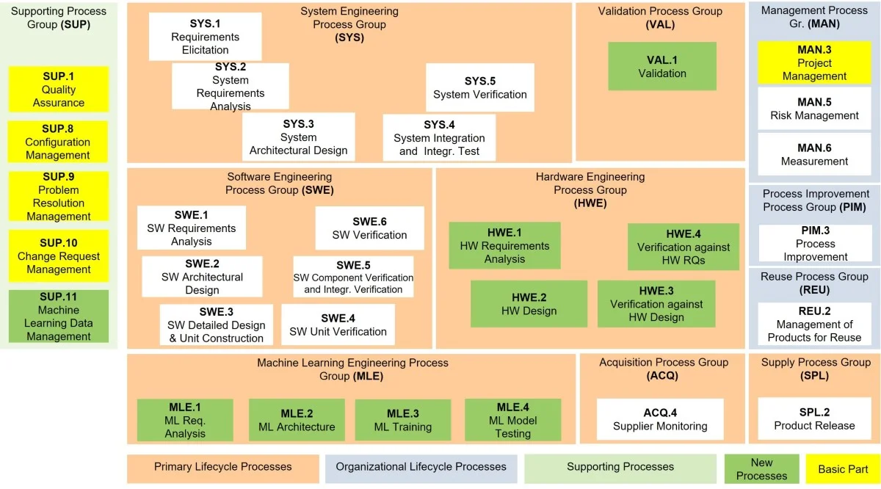
Automotive SPICE process reference model
image source: Invensity

Slide 72
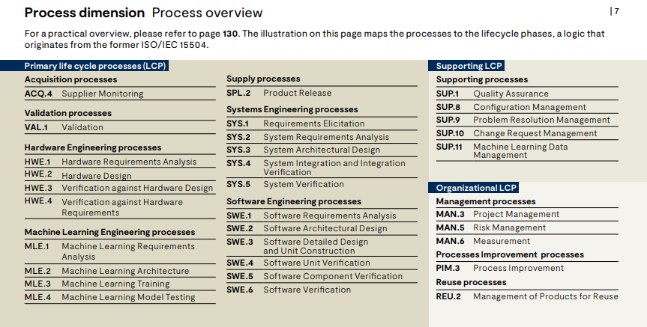
REQUIREMENTS ANALOGY IN AUTOMOTIVE SPICE

Slide 73
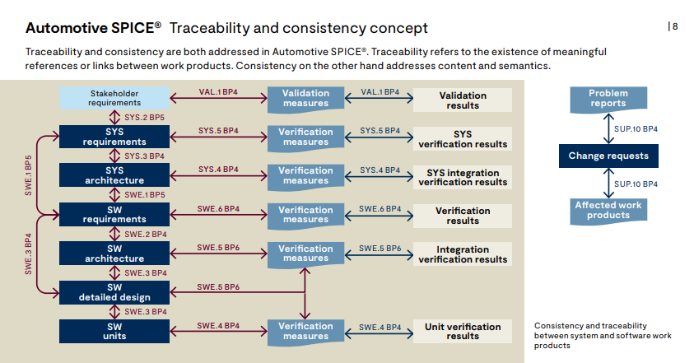
REQUIREMENTS SYS-SW TRACEBILITY AND CONSISTENCY

Slide 74
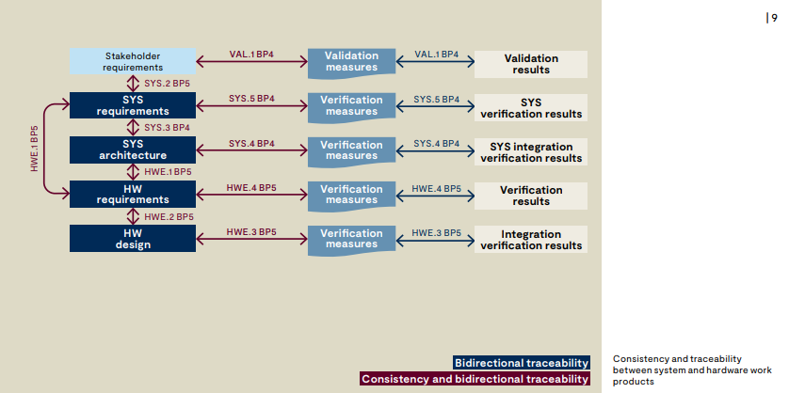
REQUIREMENTS SYS-HW TRACEBILITY AND CONSISTENCY

Slide 75
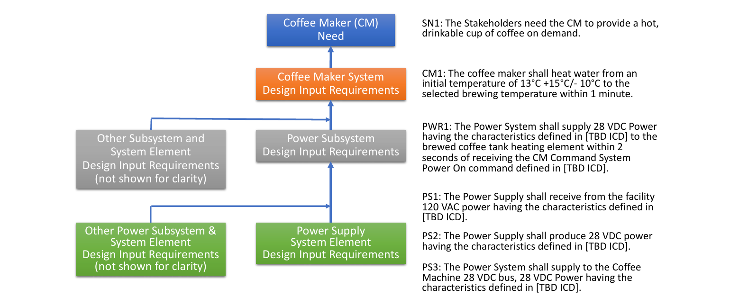
Needs -> STK Req ->Sys Req -> Sub-Sys Req
INCOSE-TP-2021-002-01 | VERS/REV: 1.1 | May 2022

Slide 76
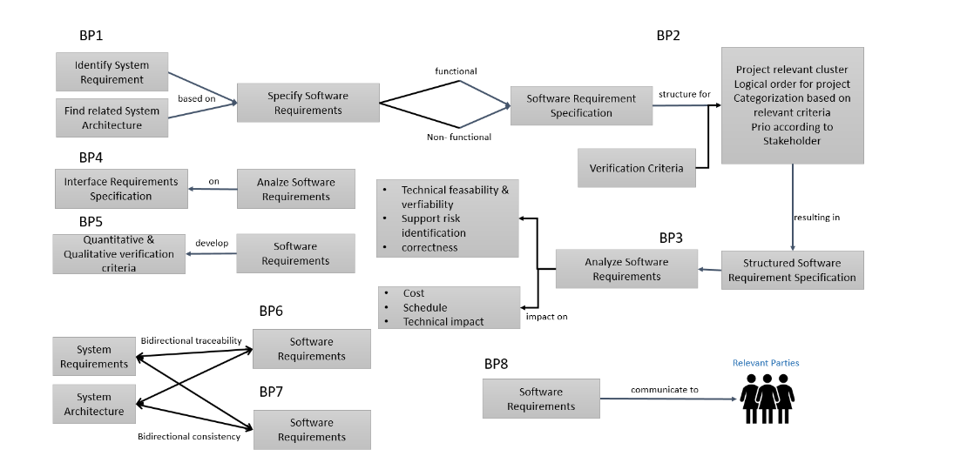
BASE PRACTICES SOFTWARE REQUIREMENTS ANALYSIS
https://polarion.code.blog/2021/04/09/swe-1-software-requirements-analysis/

Slide 77
Architecture for Requirements Breakdown

Slide 78
Architecture
“The fundamental organization of a system, embodied in its components, their relationships to each other and the environment, and the principles governing its design and evolution.”
- ISO/IEC/IEEE 42010

Slide 79
Architecture
Defines…
System functionality
System boundaries relative to other systems
External interfaces with other systems
All system components
Internal interfaces between components

Slide 80
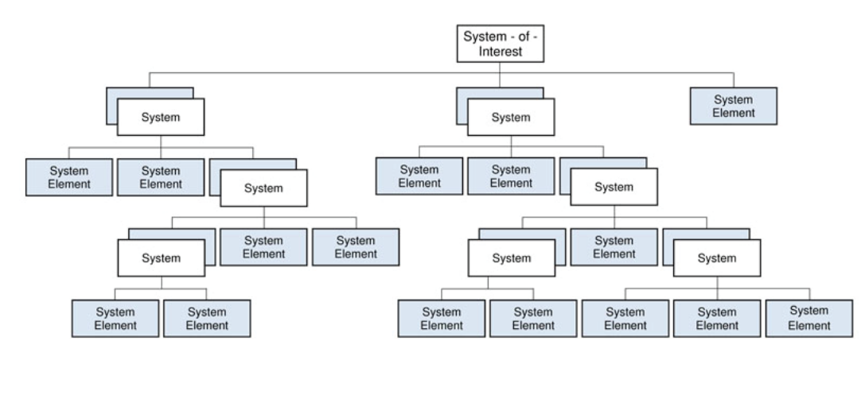
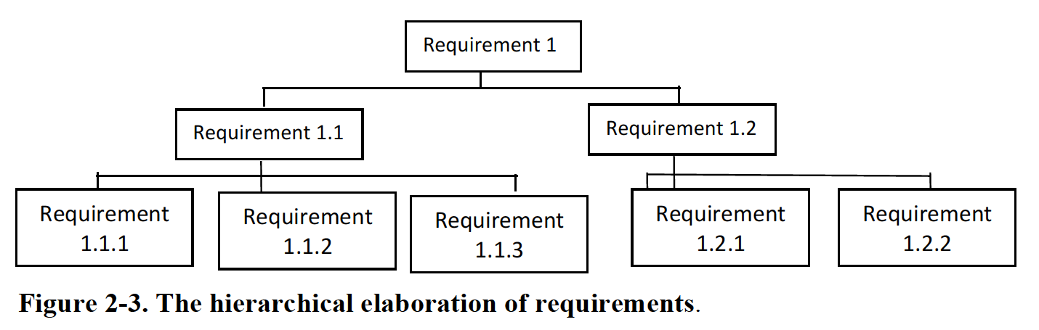
System Hierarchy
Source : SEBOK

Slide 81
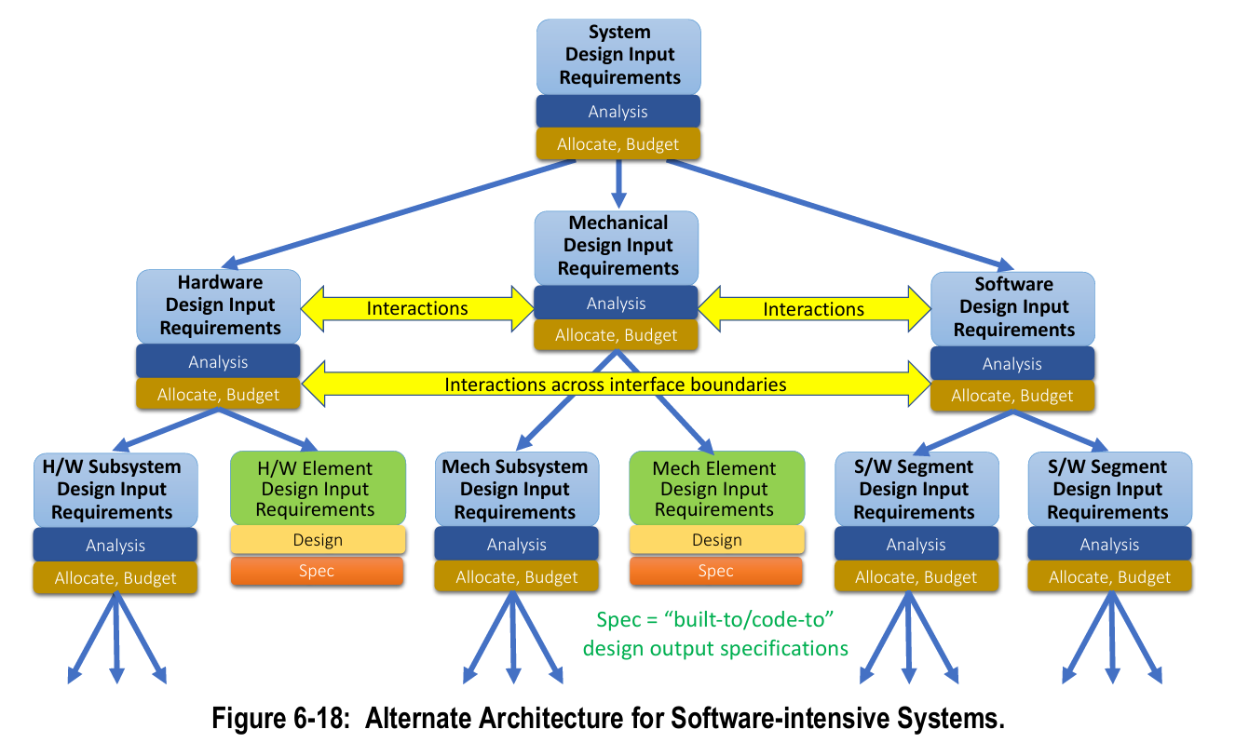
Relationship b/w Requirements for SW intensive Systems
INCOSE-TP-2021-002-01 | VERS/REV: 1.1 | May 2022
Notes:
Discussion Point : Asked the individuals to share how can they relate this diagram to their current roles.

Slide 82
High Level Module Design: Physical Decomposition & Mapping
Functional
Physical
BSD
Sensors
Wheel Speed Sensor
Radar
Dashboard
Audio
Camera
Door sensor
BSD lamp
Speaker
Detection
Distance monitor
Object classification
Warning
visual warning
Prevent Activation
BSD
Audible warning
Interrupt Activation
speed monitoring
Door status
Standstill status
Notes:
Showed as an example, but asked them to a sample breakdown of system to write requirements.

Slide 83
Discussion
1. Create a Ref Architecture of ADAS system
2. Use the same to derive next set of HW and SW requirements

Slide 84

Exercise 3.2
For your BSD ,
transform some Systems Requirements into Software Requirements (following characteristics of good sw requirements, and using the format “The <SW> shall…”)
Indicate one req in one row
Some System Requirements may translate into more than one Software Requirement

Slide 85
Exercise 3.3
For your BSD ,
transform some Systems Requirements into Hardware Requirements (following characteristics of good hw requirements, and using the format “The <SW> shall…”)
Indicate one req in one row
Some System Requirements may translate into more than one HW Requirement

Slide 86
The End

